Slide 1




XXXX – How to make a nice poster for CIRED 2023
First Name Last Name Affiliation, Country | First Name Last Name Affiliation, Country | First Name Last Name Affiliation, Country
Introduction
A poster should not contain too many text elements: do not overload your poster with text. Avoid for instance to simply present large copies - i.e. A1 or A2 format - of your original paper
Printing
Do not forget to print the first page
and bring it to the conference !!
A display board of about 1000 mm X 1500 mm ONLY (portrait format) will be provided for each author. It is strongly recommended to use standard A0 format (841 mm X 1189 mm) as printing format. Using several A4 sheets on poster board will not be allowed.
Figure 1 – An example of a person presenting
Design of the poster
Pictures, photographs, figures, graphics, workflow diagrams etc. are usually easier and more visually appealing, rather than long text blocks. Use colors!
When you use text, it is better not to use smaller font sizes than the smallest ones used in this template (Calibri: 48 points). Your poster must be legible from a 5 m distance.
Template
You are required to use the template of the CIRED 2023 conference. In the title section, change the text by your title and XXXX by your paper number.
Do not forget to change the footer with your paper number and session number.
Figure 3 – Do not forget to print your poster which is the first page of this template
E-poster
For the first time, 10 e-poster touch screens will be available in the poster area for attendees to browse through all the posters of the conference. Those screens are not intended for every author to present their work. This is the reason why you still need to print your poster. Before the conference, you will receive a link to upload your poster. If you so wish, you can add extra content in the PowerPoint file as extra pages. These extra pages should not be printed.
File size
The total PDF file size should not exceed 2 pages and 20 MB.
Conclusion
A great poster has to be readable, legible, well-organised and succinct.
We are looking forward to seeing you in Rome!
Figure 2 – A bar graph
CIRED 2023 Poster Session – Paper XXXX – Session YY

Slide 2
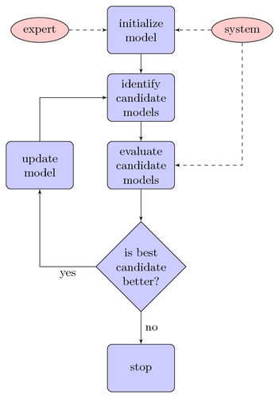
XXXX – How to make a nice poster for CIRED 2023
First Name Last Name Affiliation, Country | First Name Last Name Affiliation, Country | First Name Last Name Affiliation, Country
Extra content that you would not print but would like to be visible on the e-poster touch screens in the poster area.
Print only the first page, not the extra pages
CIRED 2023 Poster Session – Paper XXXX – Session YY

